Slide 1
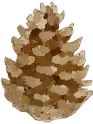
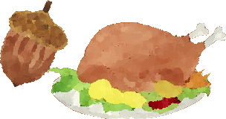
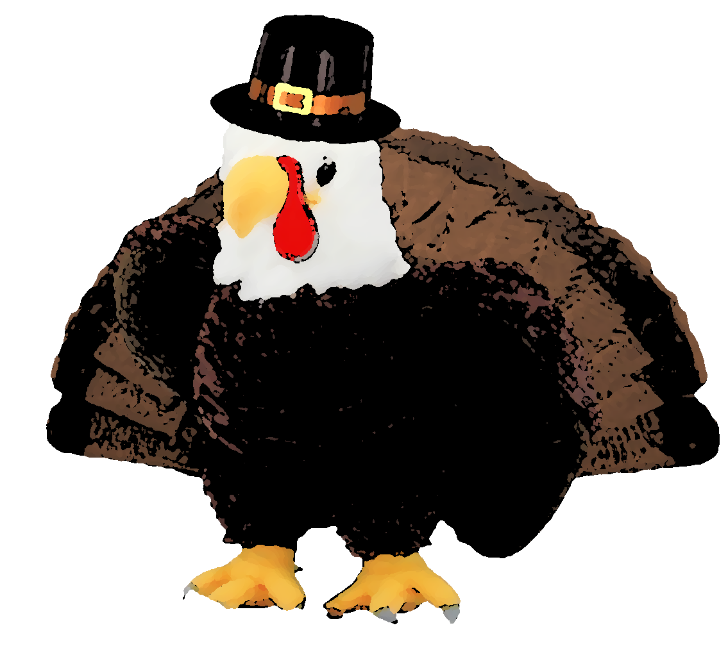
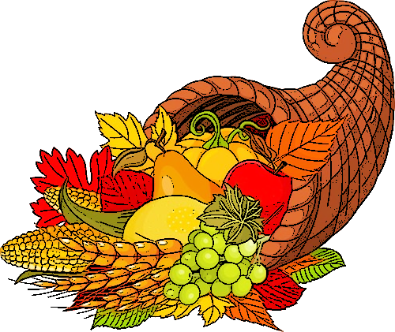
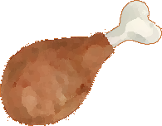
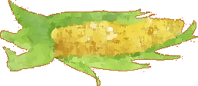
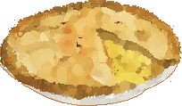
Thanksgiving Is A Time To Be Thankful…
Many things have been different this year. Some students are learning from home and mask have become a part of our wardrobes. Thanksgiving may be different for your family as well this year, but you can still enjoy your family and friends and create new traditions and memories! However your family spends the holidays, be safe and be grateful for you have a lot to be thankful for. I hope during the holidays, you take the time to discuss with your family things you are thankful for. Click on the links below to watch “ A Happy Thanksgiving Snoopy” to see how the Peanut Gang overcame being sad about not having a traditional Thanksgiving. Lastly, Kid President gives us 25 reasons to be thankful!
Happy Thanksgiving from Dr. Parkman & Harry!
https://youtu.be/WEjZjfkDYMU
https://youtu.be/yA5Qpt1JRE4
gobble
gobble
gobble
gobble
gobble
Click to stop Harry from distracting you.

